Slide 1


Slide 2

Porter Stemmer
Stemming is the process of producing
morphological variants of a root/base word.
Or in simpler words Stemming is the process
of reducing a word to its word stem into suffixes
and prefixes or to the roots of words known as a lemma.
Some examples of stemming for root word "like" include:
->"likes"
->"liked"
->"likely"
->"liking“
All these words are reduced to like!

Slide 3

ANOTHER GOOD EXAMPLE :
A stemming algorithm reduces the words
“chocolates”, “chocolatey”, “choco”
to the root word, “chocolate” !

Slide 4
Applications of stemming :
1. Stemming is used in information retrieval systems
like search engines.
2. It is used to determine domain vocabularies in
domain analysis.

Slide 5

Stemming Algorithm
A stemming algorithm is a process of linguistic normalisation,
in which the variant forms of a word are reduced to a common form,

Slide 6

Porter’s Stemmer algorithm
Porter's stemmer is one of the most popular stemming methods proposed in 1980.
It uses a single, unified approach to the handling of context.
It is based on the idea that the suffixes in the English language are made up
of a combination of smaller and simpler suffixes.
This stemmer is known for its speed and simplicity.
The main applications of Porter Stemmer include data mining and Information retrieval.

Slide 7
The Porter algorithm consists of a set of condition/action rules.
The conditions fall into three classes: conditions on the stem, conditions on the suffix,
and conditions on the rules.
There are several types of stem conditions.
1. The measure, denoted m, of a stem is based on its alternate vowel-consonant sequences.
Vowels are a, e, i, o, u, and y if preceded by a consonant.
Consonants are all letters that are not vowels.
Let C stand for a sequence of consonants, and V for a sequence of vowels.
The measure m, then, is defined as
[C](VC)^{m}[V]
The superscript m in the equation, which is the measure, indicates the number of VC sequences.
Square brackets indicate an optional occurrence. Some examples of measures for terms follows.
Measure Examples
---------------------------------------
m=0 TR, EE, TREE, BY
m=1 TROUBLE, OATS, TREES, IVY
m=2 TROUBLES, PRIVATE, OATEN

Slide 8

2. * < X >--the stem ends with a given letter X
3. *v*--the stem contains a vowel
4. *d--the stem ends in a double consonant
5. *o--the stem ends with a consonant-vowel-consonant, sequence, where the final consonant is not w, x, or y.

Slide 9
Very Simple Approach to understand Porter Algorithm by example :
Step 1a Rules
Conditions Suffix Replacement Examples
---------------------------------------------------
NULL sses ss caresses -> caress
NULL ies i ponies -> poni
ties -> tie
Step 1b Rules
Conditions Suffix Replacement Examples
----------------------------------------------------
(m>0) eed ee f eed-> feed
agreed -> agree
(*v*) ed NULL plastered-> plaster
Step 1c Rules
Conditions Suffix Replacement Examples
-----------------------------------------------------------
(*v*) y i happy - > happi
sky -> sky

Slide 10
Step 2 Rules
Conditions Suffix Replacement Examples
--------------------------------------------------------------
(m>0) ational ate relational -> relate
(m>0) tional tion conditional -> condition\
m>0) aliti al formaliti -> formal
(m>0) iviti ive sensitiviti -> sensitive
Step 3 Rules
Conditions Suffix Replacement Examples
--------------------------------------------------------
(m>0) ative NULL formative -> form
(m>0) alize al formalize -> formal
(m>0) ical ic electrical -> electric
(m>0) ful NULL hopeful -> hope
(m>0) ness NULL goodness -> good

Slide 11

Step 4 Rules
Conditions Suffix Replacement Examples
---------------------------------------------------------------------
(m>1) ance NULL allowance -> allow
(m>1) ence NULL inference -> infer
( (m>1) able NULL adjustable -> adjust
(m>1) ment NULL adjustment -> adjust
(m>1) ent NULL dependent -> depend
(m>1) iti NULL angulariti -> angular
( (m>1) ive NULL effective -> effect
Step 5a Rules
Conditions Suffix Replacement Examples
---------------------------------------------------------
(m>1) e NULL probate -> probat
rate - > rate
(m=1 and not *o) e NULL cease - > ceas
Step 5b Rules
Conditions Suffix Replacement Examples
-------------------------------------------------------------------
(m> 1 and *d) NULL single letter controll -> control

Slide 12
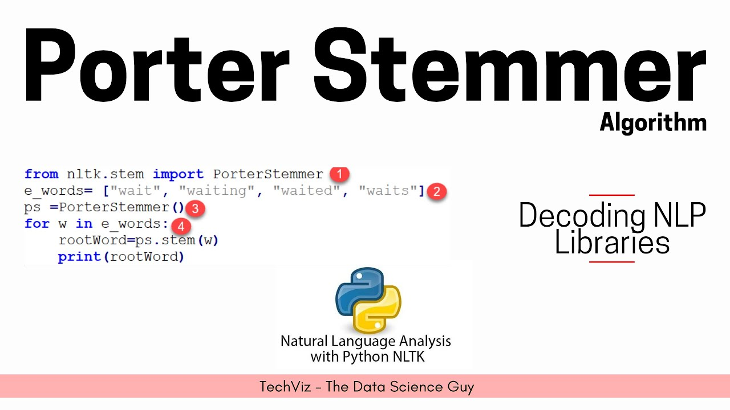
NLTK library(python):
A package called PorterStemmer is available in the NLTK library.
It makes life so much more easier for us!

Slide 13


Slide 14


